Slide 1
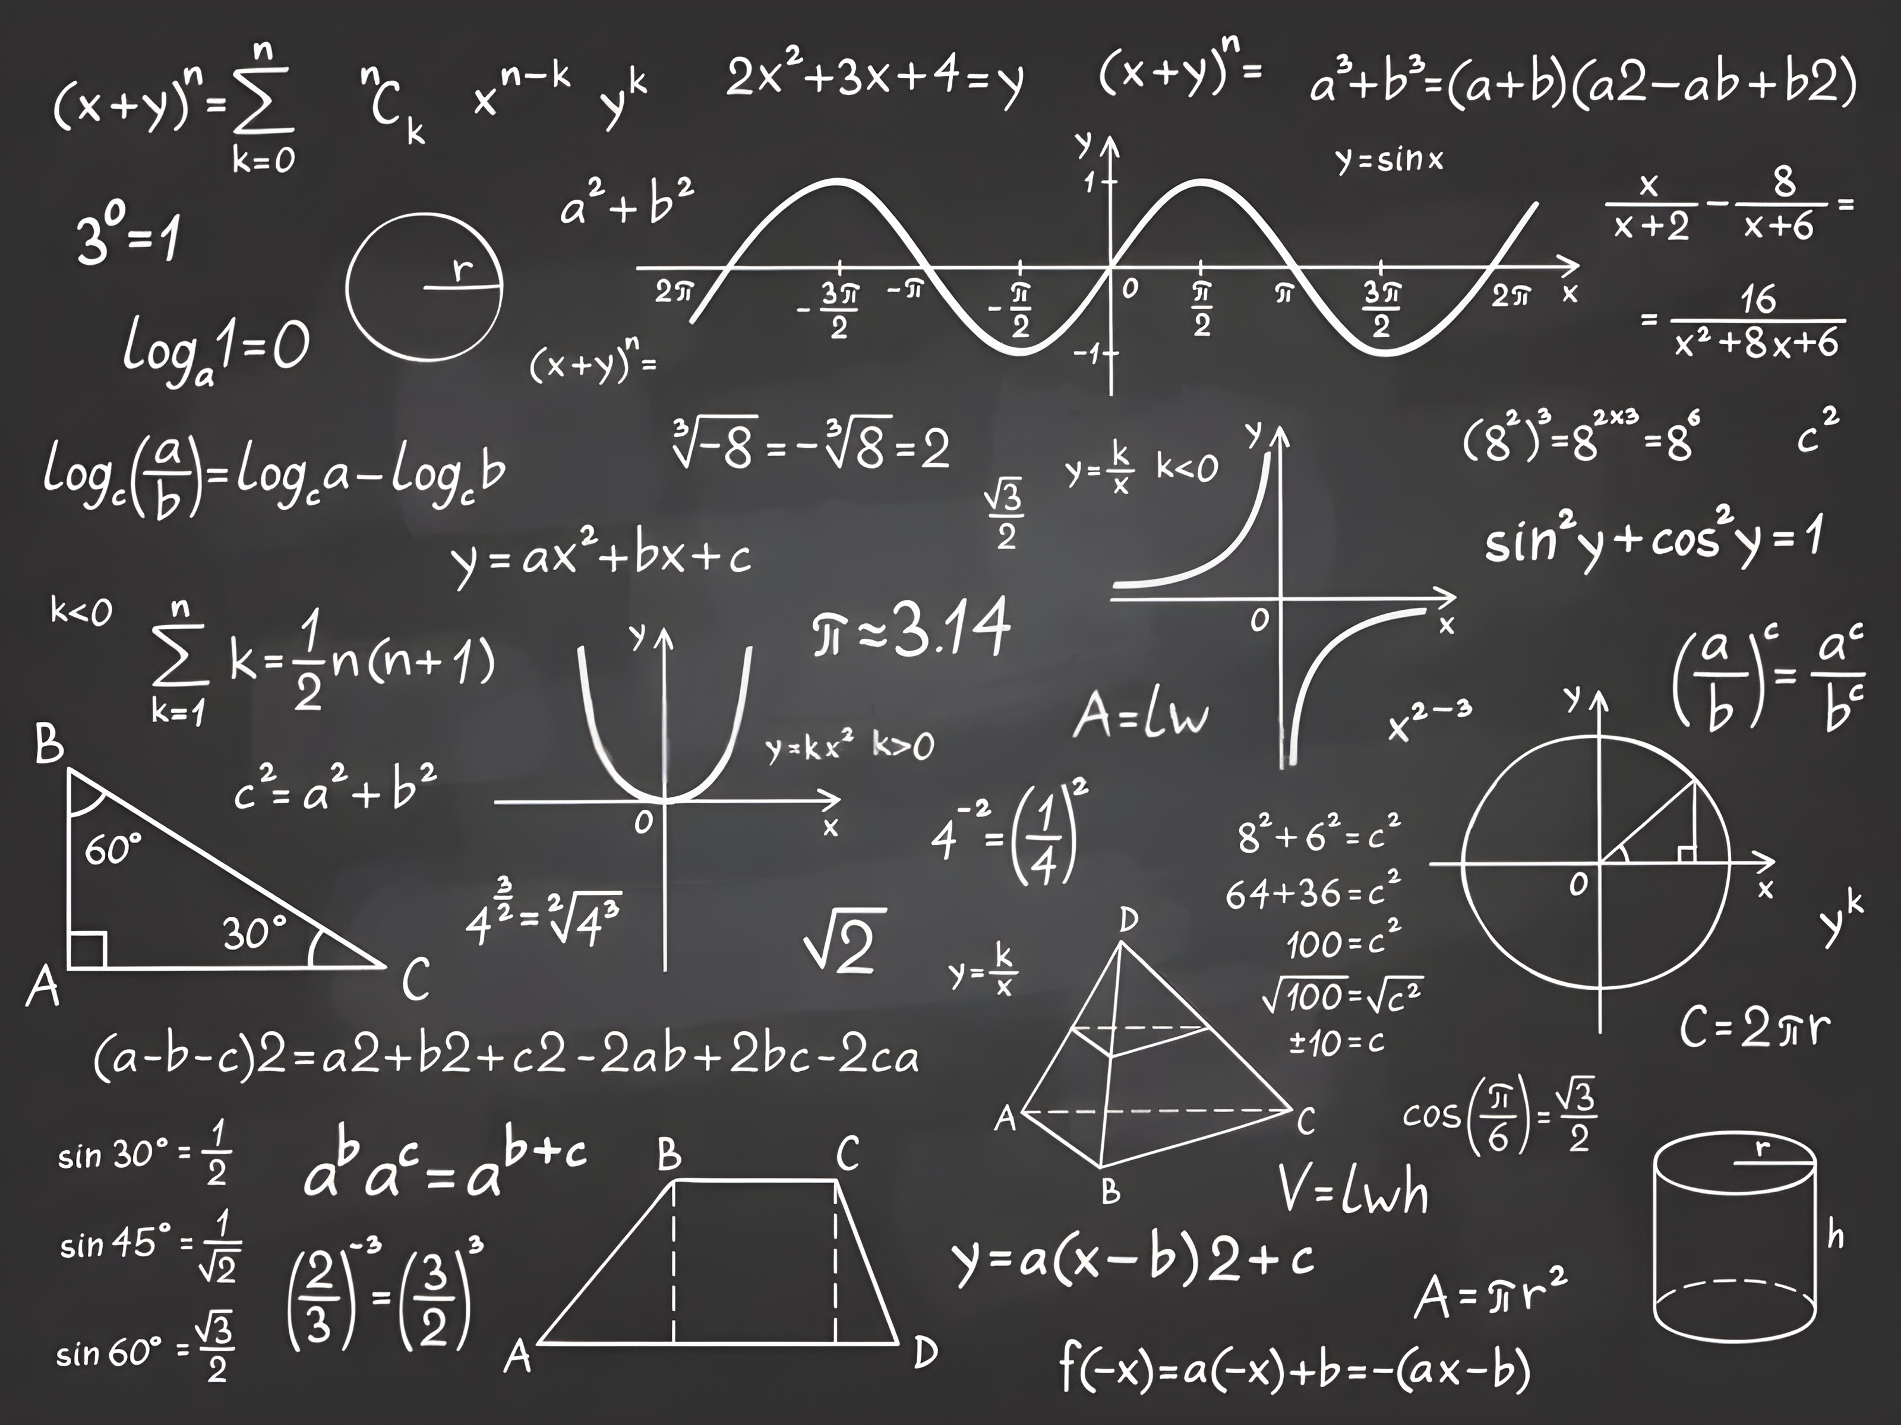
Algebra 2 with Mr. Kelly

Slide 2









Recap
$$2n −1$$
$$35x+3y+6$$
$$4n+7=27$$
$$27$$
Expressions

Slide 3




Recap
$$2n −1$$
$$35x+3y+6$$
$$4n+7=27$$
$$27$$
Pronumerals

Slide 4
Recap
$$2n −1$$
$$35x+3y+6$$
$$4n+7=27$$
$$27$$
Co-efficients

Slide 5









Recap
$$2n −1$$
$$35x+3y+6$$
$$4n+7=27$$
$$27$$
Terms

Slide 6





Recap
$$2n −1$$
$$35x+3y+6$$
$$4n+7=27$$
$$27$$
Constants

Slide 7




Recap
$$3m+ 2n −1+m$$
$$5x+3x+6$$
$$2n −7m+m+2n$$
$$4n+7nm$$
Simplification – like terms

Slide 8



Things to Watch Out For
$$7+5=\text{☐}$$
= means two expressions have the same value
$$7 + 5 = 2\text{×}6$$

Slide 9
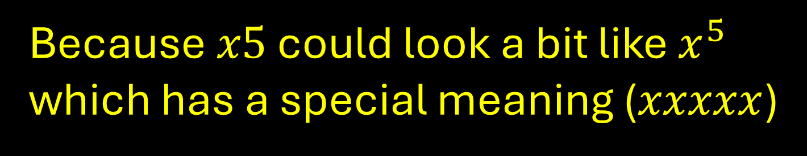
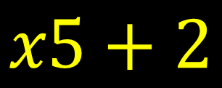

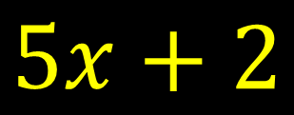

Things to Watch Out For
$$5x+2$$
and/or
$$x5+2$$
?
Because $x5$ could look a bit like $x^{5}$
which has a special meaning ($xxxxx$)

Slide 10
Inverse Operations
If we change an expression with + − × or ÷, how can we get the original expression back?
+ − × ÷
−
+
Is the Inverse of →
÷
×

Slide 11

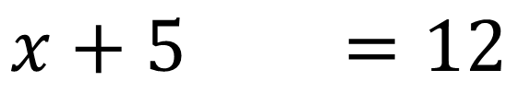
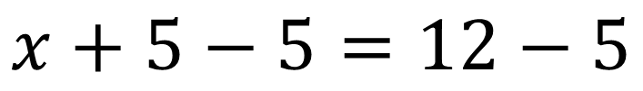
Inverse Operations can get a Pronumeral by itself
$$x+5 =12$$
$$x+5−5=12−5$$
$$x =7$$

Slide 12
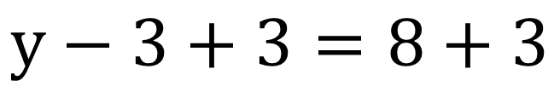

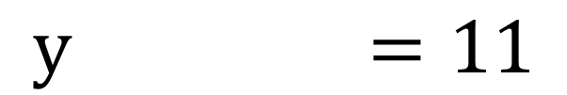
Inverse Operations can get a Pronumeral by itself
$$y−3 =8$$
$$y−3+3=8+3$$
$$y =11$$

Slide 13
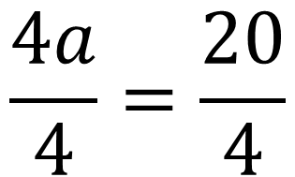
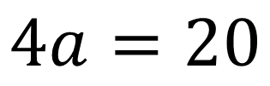
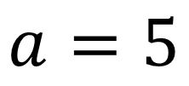
Inverse Operations can get a Pronumeral by itself
$$4a=20$$
$$\frac{4a}{4}=\frac{20}{4}$$
$$a=5$$

Slide 14
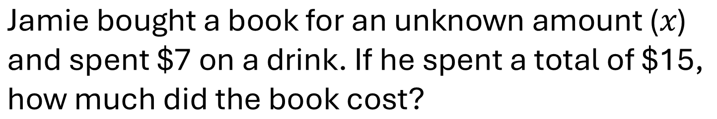
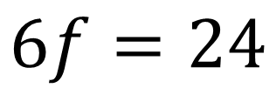
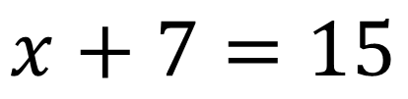
Word Problems
$$\text{Jamie} \text{bought} \text{a} \text{book} \text{for} \text{an} \text{unknown} \text{amount}\text{ (}x\text{)} \\ \text{and} \text{spent}\text{ \$7 }\text{on} \text{a} \text{drink}\text{. }\text{If} \text{he} \text{spent} \text{a} \text{total} \text{of}\text{ \$15, } \\ \text{how} \text{much} \text{did} \text{the} \text{book} \text{cost}\text{?}$$
$$x+7=15$$
$$\text{A} \text{group} \text{of} \text{friends} \text{equally} \text{shared}\text{ 24 }\text{lollies}\text{. } \\ \text{If} \text{each} \text{friend} \text{got}\text{ 6 }\text{lollies}\text{, }\text{how} \text{many} \text{friends} \text{were} \text{there}\text{?}$$
$$6f=24$$

Slide 15


Things to Watch Out For
$$x−5=\text{6}$$
We need to add 5 to both sides to get rid of the minus 5!
$$7y + 5 =19$$
Easier to get a single term with the pronumeral on one side before you do you multiply or divide!

Slide 16
“Solve” and Share
Sarah had some apples. She ate 3 apples, and now she has 5 apples left. How many apples did Sarah have to begin with?
A baker made some cookies. He sold 12 cookies, and now he has 20 cookies remaining. How many cookies did the baker make initially?
Tom bought a book for $8. He paid with a $20 bill. How much change did Tom receive?

Slide 17
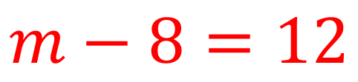
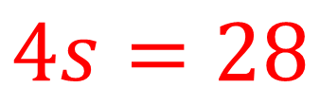
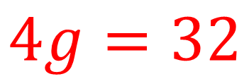
Solve individually
The perimeter of a square is 28 cm. What is the length of one side?
$$4s=28$$
After spending $8 on a movie ticket, Sarah has $12 left. How much money did she start with?
$$m−8=12$$
There are 32 students in a class. If ‘g’ groups of 4 students are formed for a project, how many groups are there?
$$4g=32$$

Slide 18
Key Ideas
Equation
Balance
Inverse Operations
Isolate the pronumeral to “solve” it

Slide 19
Exit Ticket
Take one slip of paper
Write your name clearly at the top
Answer the questions:
A number minus 7 equals 15, write the equation; what is the number?
Solve for 'y': 6y=30
When you're done, please hand it to me as you leave

